Slide 1
Type 1 and Type 2 Hypervisors

Slide 2
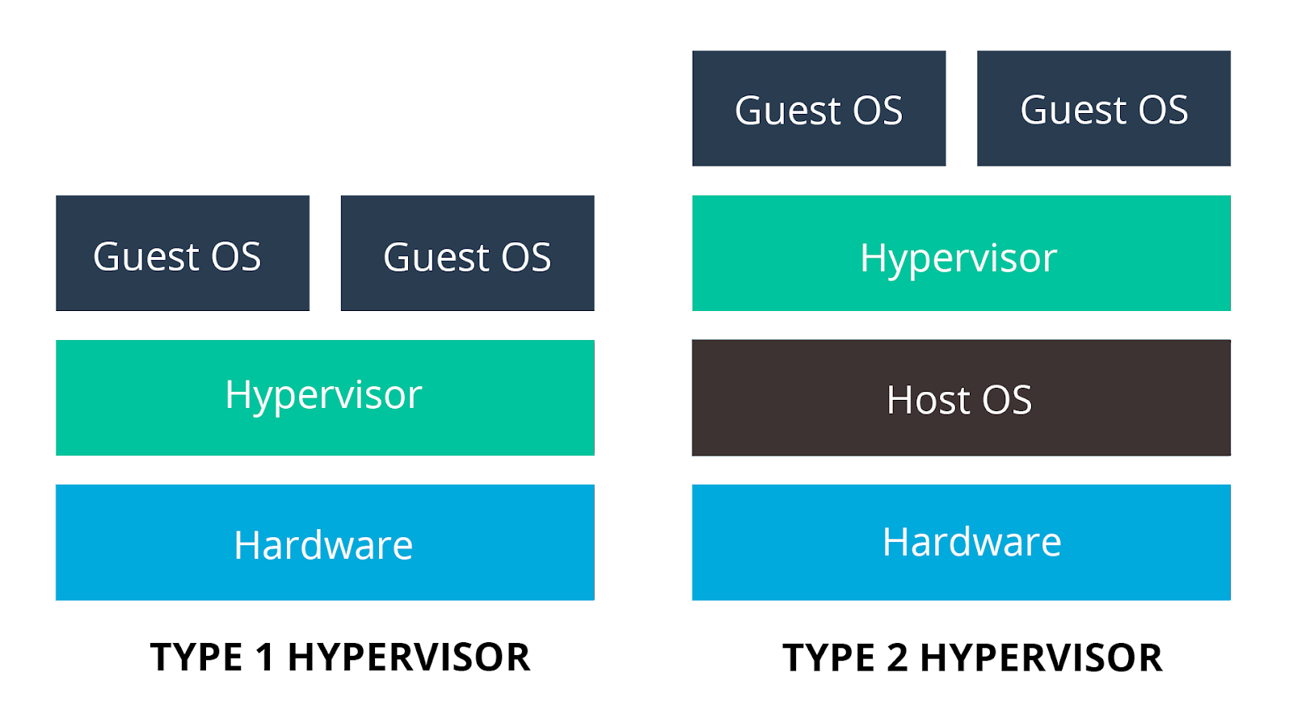

Slide 3
